Slide 2
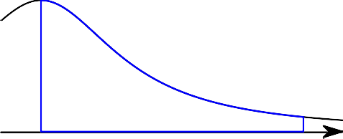
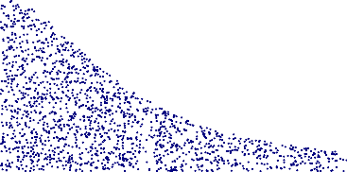
CHAPTER 7
The Integral
In this chapter we define the integral of a function on some interval [a, b]. The most common interpretation of the integral is in terms of the area under the graph of the given function, so that is where we begin.
1. Area under a Graph
y = f (x)
a b
Let f be a function which is defined on some interval a ≤ x ≤ b and assume it is positive, i.e. assume that its graph lies above the x axis. How large is the area of the region caught between the x axis, the graph of y = f (x) and the vertical lines y = a and y = b?
You can try to compute this area by approximating the region with many thin rectangles. Look at figure 1before you read on. To make the approximating region you choose a partition of the interval [a, b], i.e. you pick numbers x₁ < · · · < x_{n} with
a = x₀ < x₁ < x₂ < · · · < x_{n−1} < x_{n} = b.
These numbers split the interval [a, b] into n sub-intervals
[x₀, x₁], [x₁, x₂], . . . , [x_{n−1}, x_{n}]
whose lengths are
∆x₁ = x₁ − x₀, ∆x₂ = x₂ − x₁, . . . , ∆x_{n} = x_{n} − x_{n−1}.
In each interval we choose a point c_{k} , i.e. in the first interval we choose x₀ ≤ c₁ ≤ x₁, in the second interval we choose x₁ ≤ c₂ ≤ x₂, . . . , and in the last interval we choose some number x_{n−1} ≤ c_{n} ≤ x_{n}. See figure1.
We then define n rectangles: the base of the k^{th} rectangle is the interval [x_{k−1}, x_{k} ] on the x-axis, while its height is f (c_{k} ) (here k can be any integer from 1 to n.)
The area of the k^{th} rectangle is of course the product of its height and width, i.e. its area is f(c_{k} )∆x_{k} .
Adding these we see that the total area of the rectangles is
(47) R = f (c₁)∆x₁ + f (c₂)∆x₂ + · · · + f (c_{n})∆x_{n}. This kind of sum is called a Riemann sum.
If the partition is sufficiently fine then one would expect this sum, i.e. the total area of all rectangles to be a good approximation of the area of the region under the graph. Replacing the partition by a finer partition, with more division points, should improve the approximation. So you would expect the area to be the limit of Riemann-sums like R “as the partition becomes finer and finer.” A precise formulation of the definition goes like this:

Slide 3
a = x₀
c₁
x₁
c₂
x₂
c₃
x₃ x₄
x₅
b = x₆
c₄
c₅
c₆
a b
Figure 1. TOP. A Riemann sum in which the interval a < x < b has been cut up into six smaller intervals. In each of those intervals a point ci has been chosen at random, and the resulting rectangles with heights f (c1), . . . , f (c6) were drawn. The total area under the graph of the function is roughly equal to the total area of the rectangles. BOTTOM. Refining the partition. After adding more partition points the combined area of the rectangles will be a better approximation of the area under the graph of the function f .
1.1. Deftnition. If f is a function defined on an interval [a, b], then we say that
∫
b
f (x)dx = I,
a
i.e. the integral of “f (x) from x = a to b” equals I, if for every ε > 0 one can find a δ > 0 such that
f (c₁)∆x₁ + f (c₂)∆x₂ + · · · + f (c_{n})∆x_{n} − I. < ε
holds for every partition all of. whose intervals have length ∆x_{k} < δ.
2. When f changes its sign
If the function f is not necessarily positive everywhere in the interval a ≤ x ≤ b, then we still define the integral in exactly the same way: as a limit of Riemann sums whose mesh size becomes smaller and smaller. However the interpretation of the integral as “the area of the region between the graph and the x-axis” has a twist to it.
Let f be some function on an interval a ≤ x ≤ b, and form the Riemann sum
R = f (c₁)∆x₁ + f (c₂)∆x₂ + · · · + f (c_{n})∆x_{n}

Slide 4
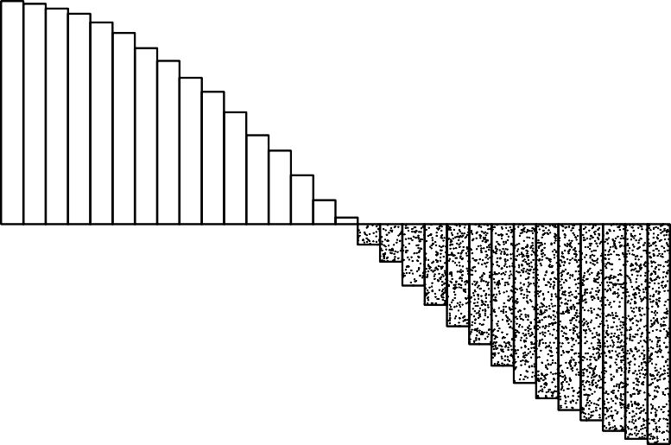
b
a
Figure 2. Illustrating a Riemann sum for a function whose sign changes. Always remember this: AREAS ARE ALWAYS POSITIVE NUMBERS. The Riemann-sum corresponding to this picture is the total area of the rectangles above the x-axis minus the total area of the rectangles below the x-axis.
that goes with some partition, and some choice of c_{k} .
When f can be positive or negative, then the terms in the Riemann sum can also be positive or negative. If f(c_{k} ) > 0 then the quantity f(c_{k} )∆x_{k} is the area of the corresponding rectangle, but if f(c_{k} ) < 0 then f (c_{k} )∆x_{k} is a negative number, namely minus the area of the corresponding rectangle. The Riemann sum is therefore the area of the rectangles above the x-axis minus the area below the axis and above the graph.
Taking the limit over finer and finer partitions, we conclude that
∫
b
f (x)dx =
area above the x-axis, below the graph
minus the area below the x-axis, above the graph.
a
3. The Fundamental Theorem of Calculus
3.1. Deftnition. A function F is called an antiderivative of f on the interval [a, b] if one has F ^{j}(x) =
f (x) for all x with a < x < b.
For instance, F (x) = ¹ x² is an antiderivative of f (x) = x, but so is tt(x) = ¹ x² + 2008.
2 2
∫
b
3.2. Theorem. If f is a function whose integral f (x)dx exists, and if F is an antiderivative of f on
the interval [a, b], then one has
a
∫
b
(48) f (x)dx = F (b) − F (a).
a
(a proof was given in lecture.)
Because of this theorem the expression on the right appears so often that various abbreviations have been invented. We will abbreviate
Σ Σ Σ Σ
def b b
F (b) − F (a) = F (x) _{x=a} = F (x) _{a}.
4

